Slide 1
Programming for Engineers in Python
Fall 2019-2020
Lecture 7: Memoization

Slide 2
Plan
Memoization – A dynamic programming technique:
Examples:
Fibonacci
Sublist sum
Knapsac
LCS
(* If time permits)
2

Slide 3

Memoization
A trick for speeding up recursions…

Slide 4

Remember Fibonacci Series?
Fibonacci series
0, 1, 1, 2, 3, 5, 8, 13, 21, 34
Definition:
fib(0) = 0
fib(1) = 1
fib(n) = fib(n-1) + fib(n-2)

Slide 5
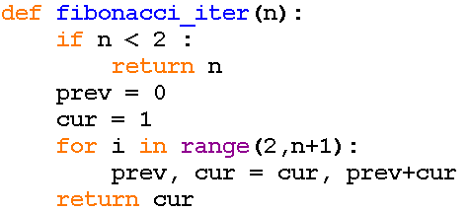
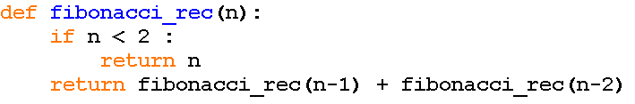
Recursion Efficiency
So far we haven’t discussed the efficiency of a recursive solution, compared to an iterative one.
Lets take Fibonacci as an example:

Slide 6
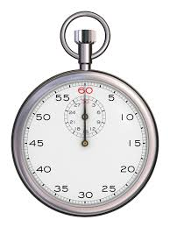
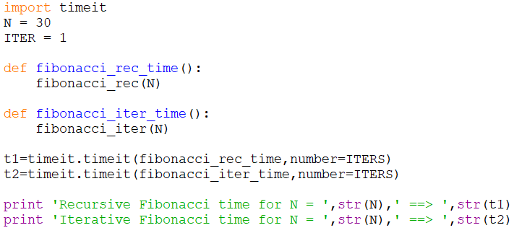

Timing Fibonacci
The recursive version is ${∗10}^{6}$ slower than the Iterative one
Output (shell):
6

Slide 7
Recursive Fibonacci Series
def fibonacci(n):
if n < 2:
return n
return fibonacci(n-1) + fibonacci(n-2)
Every call with n > 1 invokes 2 function calls, and so on…
The recursive version is much slower because..
Recursion overhead (jumping between function executions)
Exponentially increasing number of redundant calls (recalculating the same sub-problems over and over …)

Slide 8
Redundant Calls
Fib(5)
Example: redundant calculations
Fib(4)
Fib(3)
Fib(3)
Fib(2)
Fib(2)
Fib(1)
Fib(2)
Fib(1)
Fib(1)
Fib(0)
Fib(1)
Fib(1)
Fib(0)
Fib(0)

Slide 9
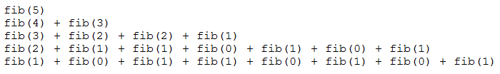
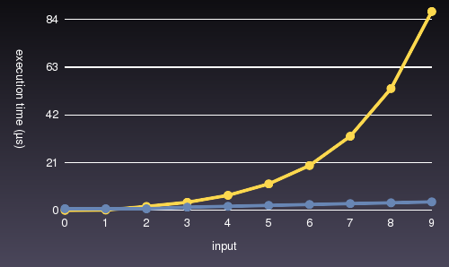
Redundant Calls
Iterative vs. recursive Fibonacci

Slide 10
Number of Calls to Fibonacci
n | value | Number of calls
1 | 1 | 1
2 | 1 | 3
3 | 2 | 5
23 | 28657 | 92735
24 | 46368 | 150049

Slide 11

Memoization
Problem
Some recursions recalculate the same sub-problems over and over.
Idea
Solve each sub-problem once.
Use the solution whenever this sub-problem is encountered again.

Slide 12
Memoization
The Memoization idea
Identify each sub-problem uniquely.
Store the sub-problem solutions in a data structure.
Before calculating a sub-problem by making a recursive call – check if it was already solved before.
http://en.wikipedia.org/wiki/Memoization

Slide 13

Unique sub-problem identification
How can we uniquely identify each sub-problem (to make sure we don’t recalculate it again)?
A tuple of the input arguments
In the case of a list – its length or description of its content

Slide 14


Storing the Solutions
Options
List – one enumerable input value (Fibonacci)
Nested lists – multiple enumerable values
Note: initialize with a special value that indicates an unsolved problem (None / -1/ something else)
Dictionary – key: a tuple
describing the input

Slide 15
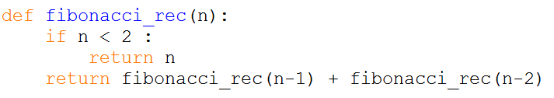
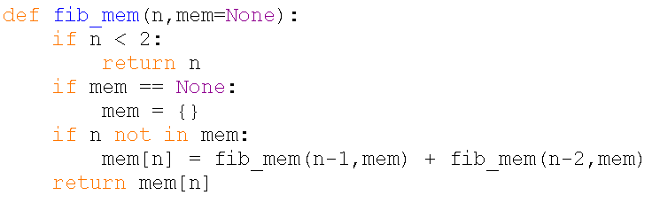
Example 1
Fibonacci with Memoization

Slide 16
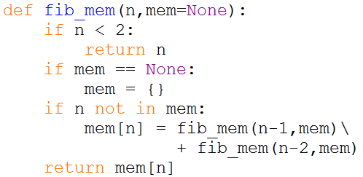
How does it work?
n = 4

Slide 17
How does it work?
n = 4

Slide 18
How does it work?
n = 4
mem = {}

Slide 19
How does it work?
n = 4
mem = {}

Slide 20
How does it work?
n = 4
mem = {}

Slide 21
How does it work?
n = 4
mem = {}
n = 3
mem = {}

Slide 22
How does it work?
n = 4
mem = {}
n = 3
mem = {}

Slide 23
How does it work?
n = 4
mem = {}
n = 3
mem = {}

Slide 24
How does it work?
n = 4
mem = {}
n = 3
mem = {}

Slide 25
How does it work?
n = 4
mem = {}
n = 3
mem = {}
n = 2
mem = {}

Slide 26
How does it work?
n = 4
mem = {}
n = 3
mem = {}
n = 2
mem = {}

Slide 27
How does it work?
n = 4
mem = {}
n = 3
mem = {}
n = 2
mem = {}

Slide 28
How does it work?
n = 4
mem = {}
n = 3
mem = {}
n = 2
mem = {}

Slide 29
How does it work?
n = 4
mem = {}
n = 3
mem = {}
n = 2
mem = {}
n = 1
mem = {}

Slide 30
How does it work?
n = 4
mem = {}
n = 3
mem = {}
n = 2
mem = {}
1
n = 1
mem = {}

Slide 31
How does it work?
n = 4
mem = {}
n = 3
mem = {}
n = 2
mem = {}
1

Slide 32
How does it work?
n = 4
mem = {}
n = 3
mem = {}
n = 2
mem = {}
1
n = 0
mem = {}

Slide 33
How does it work?
n = 4
mem = {}
n = 3
mem = {}
n = 2
mem = {}
1
0
n = 0
mem = {}

Slide 34
How does it work?
n = 4
mem = {}
n = 3
mem = {}
n = 2
mem = {}
1
0

Slide 35
How does it work?
n = 4
mem = {2:1}
n = 3
mem = {2:1}
n = 2
mem = {2:1}

Slide 36
How does it work?
n = 4
mem = {2:1}
n = 3
mem = {2:1}
1
n = 2
mem = {2:1}

Slide 37
How does it work?
n = 4
mem = {2:1}
n = 3
mem = {2:1}
1

Slide 38
How does it work?
n = 4
mem = {2:1}
n = 3
mem = {2:1}
1
n = 1
mem = {2:1}

Slide 39
How does it work?
n = 4
mem = {2:1}
n = 3
mem = {2:1}
1
1
n = 1
mem = {2:1}

Slide 40
How does it work?
n = 4
mem = {2:1}
n = 3
mem = {2:1}
1
1

Slide 41
How does it work?
n = 4
mem = {2:1, 3:2}
n = 3
mem = {2:1 , 3:2}

Slide 42
How does it work?
2
n = 4
mem = {2:1, 3:2}
n = 3
mem = {2:1 , 3:2}

Slide 43
How does it work?
2
n = 4
mem = {2:1, 3:2}

Slide 44
How does it work?
2
n = 4
mem = {2:1, 3:2}
n = 2
mem = {2:1 , 3:2}

Slide 45
How does it work?
2
n = 4
mem = {2:1, 3:2}
n = 2
mem = {2:1 , 3:2}

Slide 46

How does it work?
2
n = 4
mem = {2:1, 3:2}
n = 2
mem = {2:1 , 3:2}

Slide 47
How does it work?
2
n = 4
mem = {2:1, 3:2}
1
n = 2
mem = {2:1 , 3:2}

Slide 48
How does it work?
2
n = 4
mem = {2:1, 3:2}
1

Slide 49
How does it work?
n = 4
mem = {2:1, 3:2, 4:3}

Slide 50
How does it work?
n = 4
mem = {2:1, 3:2, 4:3}
3

Slide 51
Timeit
def fib_mem_time():
fib_mem(N)
ITERS = 1
N = 32
T3 = timeit.timeit(fib_mem_time, number=ITERS)
print ‘Memoization fib for N =‘,str(N),’==>’,str(T3)
Output (shell):
Iterative fib for N = 32 ==> 7.67930389212e-06
Recursive fib for N = 32 ==> 1.26163318548
Memoization fib for N = 32 ==> 4.04908750671e-05

Slide 52
Memoization
Memoization reduces computation by:
Storing solution to a sub-problem the first time it is solved
Looking up the solution when sub-problem is encountered again
Memoization is usually used when solving problems with overlapping subproblems:
Examples:
Factorial - does not exhibit overlapping
sub-problems
- Fibonacci does

Slide 53
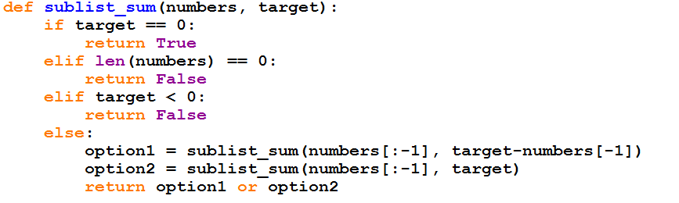
Example 2: Sub-list sum
numbers is a list of positive integers.
Is there a sub list of numbers so its sum equals target?
The solution is recursive:

Slide 54
Can memoization help?
Consider the case: numbers = [3,2,1,1], target = 5
numbers = [3,2,1,1] , target = 5
numbers = [3,2,1] , target = 4
numbers = [3,2,1] , target = 5
numbers = [3,2]
target = 3
numbers = [3,2]
target = 4
numbers = [3,2]
target = 4
numbers = [3,2]
target = 5
Colored in blue: numbers[-1]
Green arrow: option 1, numbers[-1] is in the sublist
Red arrow: option 2, numbers[-1] is not in the sublist

Slide 55
Sublist sum
def sublist_sum(numbers, target)
What would be the memoization key?
The arguments for sublist_sum are: numbers and target
numbers and target both change.
Can the key be (numbers, target)?
No, the key must be immutable
In that case, we’ll use (len(numbers), target)
Since we always take one element from the end of numbers, if len(numbers) = k, it means that numbers contains the first k elements of the original numbers list.

Slide 56
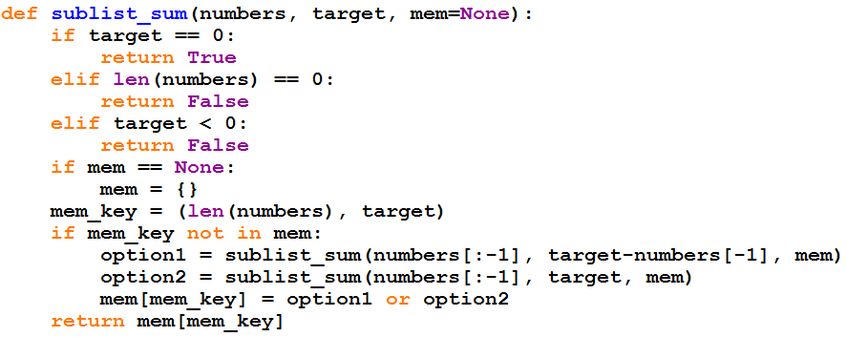
Sublist sum with memoization

Slide 57
Optimizing Shipping Cargo (Knapsack)
A shipping company is trying to sell
1000 metric tones capacity in a cargo ship to different shippers by an auction
The company received 100 different offers from potential shippers
Each offer includes: weight, offered reward
57

Slide 58

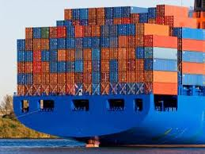
Optimizing Shipping Cargo (Knapsack)
The company wish to select a subset of the offers m₁, …, m_{k} such that:
Their total weight fits into the capacity
They maximize the total reward
58

Slide 59
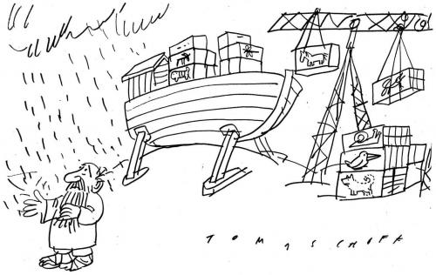
Formalizing
Shipping capacity W = 1000
Offers from potential shippers n = 100
Each offer i:
weight w_{i} , an offered reward v_{i}
Maximize the reward given the W tonnage limit
Return the maximum reward
59

Slide 60

First Try - Greedy
Sort offers i by v_{i}/w_{i} ratio
Select offers until the ship is full
Counter example: W = 10, {(v_{i},w_{i})} = {(7,7),(4,5),(4,5)}
The greedy choice
The best choice
60

Slide 61
Formaly define KS(i,j)
Given:
offers – list of tuples, each representing an offer
W – the initial capacity of the ship
We define the function KS(i, j).
KS(i, j) returns the maximum reward that can be obtained considering:
1. the ship’s current capacity is j
2. the only available offers are all offers in the offers list, starting from the index 0 until the offer in index i (meaning, indices <= i)
61

Slide 62
Pseudo code for the correct solution
let’s consider the i’th offer:
if the offer exceeds the capacity of the ship, we must skip it and move to the other option
Otherwise, we should consider two options:
Skip the i’th offer
Take the i’th offer
Then, we will select the best option (best option = the maximum reward between the two option).
Return the maximum reward
62

Slide 63
Solution
Base cases
if j==0: return 0 #no more capacity on the ship
if i == 0: return 0 #no more offers
w₁
v₁
w₂
v₂
w_{i}
v_{i}
w_{n}
v_{n}
j
63

Slide 64
Solution
What are the smaller sub-problems?
First case: w_{i} > j :
we should skip the i’th offer.
=> the maximum profit is the maximum profit for the rest of the i-1 offers.
w₁
v₁
w₂
v₂
w_{i}
v_{i}
w_{n}
v_{n}
j
w₁
v₁
w₂
v₂
w_{i-1}
v_{i-1}
w_{i}
v_{i}
64

Slide 65
Solution
Second case: w_{i} ≤ j :
w₁
v₁
w₂
v₂
w_{i}
v_{i}
w_{n}
v_{n}
Either skip the i’th offer
j
w₁
v₁
w₂
v₂
w_{i-1}
v_{i-1}
Or take the i’th offer
j
v_{i}
+
w₁
v₁
w₂
v₂
w_{i-1}
v_{i-1}
w_{i}
KS(i, j) = max(KS(i-1,j), v_{i} + KS (i-1, j-w_{i})

Slide 66
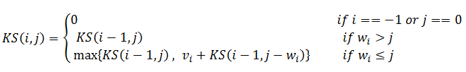
Solution
Which choice should we make?
Whichever is larger! the maximum of the two.
Formally:
w₁
v₁
w₂
v₂
w_{i}
v_{i}
w_{n}
v_{n}
j
66

Slide 67
Optimal Substructure and Overlapping Subproblems
Overlapping subproblems: at any stage (i,j) we might need to calculate KS(k,l) for several k < i and l < j.
Optimal substructure: at any point we only need information about the choices we have already made.
67

Slide 68
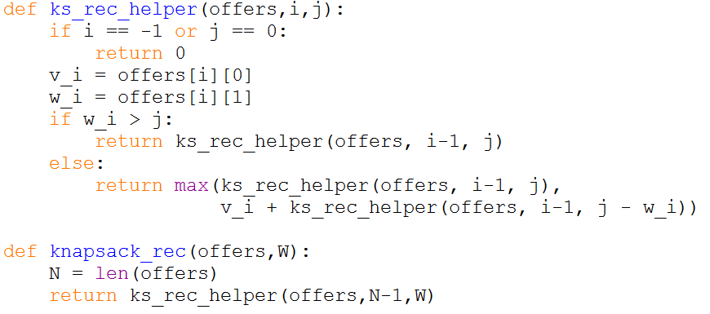

Solution (Recursive)
68

Slide 69

Solution (Memoization) – The Idea
What is the memoization dictionary key?
The key should hold the unique information of each call, derived from the arguments to the recursive function:
Let’s examine the arguments:
1. offers: a list, doesn’t change in any recursive call
2. i: an integer, changes each recursive call
3. j: an integer, changes in some calls.
69

Slide 70
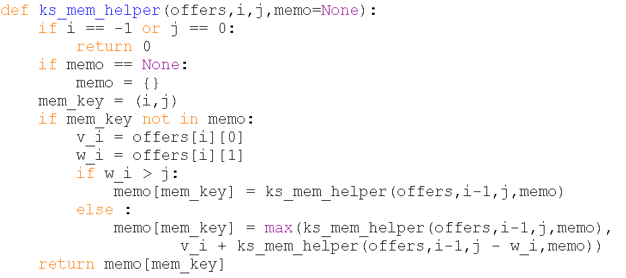
Solution (Memoization) - Code
# this is the unique key
70

Slide 71
Steps in Dynamic Programming
Characterize structure of an optimal solution
Define value of optimal solution recursively
Compute optimal solution values in a top-down manner (memoization)
Construct an optimal solution from computed values

Slide 72

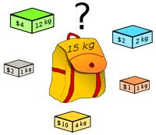
Why Knapsack?
בעיית הגנב
http://en.wikipedia.org/wiki/Knapsack_problem

Slide 73
Longest Common Subsequence
Subsequence Definition B is a subsequence of A if B can be derived from A by removing elements from A
Examples
[2,4,6] is a subsequence of [1,2,3,4,5,6]
[6,4,2] is NOT a subsequence of [1,2,3,4,5,6]
‘is’ is a subsequence of ‘distance’
‘nice’ is NOT a subsequence of ‘distance’

Slide 74
Longest Common Subsequence
Given two subsequences (strings or lists) we want to find the longest common subsequence (LCS):
Example:
Sequence 1: HUMAN
Sequence 2: CHIMPANZEE
Applications include:
Bioinformatics (next up)
Version Control
http://wordaligned.org/articles/longest-common-subsequence

Slide 75
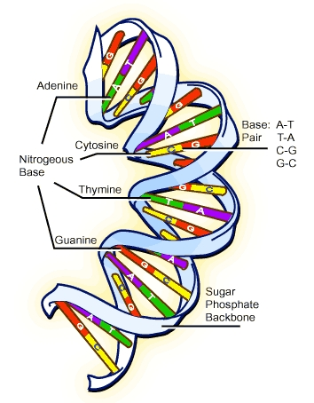
The DNA
Our biological blue-print
A sequence made of four bases – A, G, C, T
Double strand:
A connects to T
G connects to C
Triplet can encodes for amino-acids
Example: GAG→Glutamate
A chain of amino-acids is a protein – the biological machine!
http://sips.inesc-id.pt/~nfvr/msc_theses/msc09b/

Slide 76

Longest Common Subsequence
The DNA changes:
Mutation: A→G, C→T, etc.
Insertion: AGC → ATGC
Deletion: AGC → A‒C
Given two non-identical sequences, we want to find the parts that are common
So we can say how different they are?
Which DNA is more similar to ours? The cat’s or the dog’s?
http://palscience.com/wp-content/uploads/2010/09/DNA_with_mutation.jpg

Slide 77
Recursive solution
pref1
c1_last
c2_last
pref2
HUMAN
CHIMPANZEE
seq1
seq2
Observation:
If the last characters of both strings are identical, they are part of the substring.
Otherwise, we have 3 options:
c1_last is part of the LCS
c2_last is part of the LCS
Both c1_last and c2_last are not part of the LCS

Slide 78
Recursion – pseudo code
last_x
last_y
Find the length of the LCS of seq₁ and seq₂.
Base:
if x or y is empty, the length of LCS = 0
Step:
if last_x == last_y:
LCS = lcs_rec(prefix_x, prefix_y) + 1
x = x₁x₂x₃x₄x₅
y = y₁y₂y₃y₄
prefix_x
prefix_y
lcs_rec(“abc”, “ac”) =
lcs_rec(“ab”, “a”) + 1

Slide 79
Recursion – pseudo code
last_x
last_y
Find the length of the LCS of seq₁ and seq₂.
Base:
if x or y is empty, the length of LCS = 0
Step:
if last_x == last_y:
LCS = lcs_rec(prefix_x, prefix_y) + 1
else:
choose the longer LCS out of:
lcs_rec(prefix_x, y) and lcs_rec(x, prefix_y)
x = x₁x₂x₃x₄x₅
y = y₁y₂y₃y₄
prefix_x
prefix_y
What about the option lcs_rec(prefix_x, prefix_y)?

Slide 80
Example
recursive calls
returned value
0
x = “ab”
y = “bc”
1
x = “a”
y = “bc”
x = “ab”
y = “b”
0
0
0
x = “”
y = “bc”
x = “a”
y = “b”
x = “a”
y = “”
0
0
x = “”
y = “b”
x = “a”
y = “”

Slide 81
Recursion
#Base: Check if either sequence is empty:
If len(x) == 0 or len(y) == 0:
return 0
#Step: Build solution from shorter sequences:
If x[-1] == y[-1]:
return lcs_rec(x[:-1],y[:-1]) + 1
else:
return max(lcs_rec(x[:-1],y), lcs_rec(x,y[:-1]))

Slide 82
Wasteful Recursion
>>> lcs('MAN', 'PIG')
Count the number of calls with different parameters:
(1, ('', 'PIG')) (1, ('M', 'PIG')) (1, ('MA', 'PIG')) (1, ('MAN', '')) (1, ('MAN', 'P')) (1, ('MAN', 'PI')) (1, ('MAN', 'PIG')) (2, ('MA', 'PI')) (3, ('', 'PI')) (3, ('M', 'PI')) (3, ('MA', '')) (3, ('MA', 'P')) (6, ('', 'P')) (6, ('M', '')) (6, ('M', 'P'))
24 redundant calls!
http://wordaligned.org/articles/longest-common-subsequence

Slide 83

Wasteful Recursion
When comparing longer sequences with a small number of letters the problem is worse
For example, DNA sequences are composed of A, G, T and C, and are long
lcs('ACCGGTCGAGTGCGCGGAAGCCGGCCGAA', 'GTCGTTCGGAATGCCGTTGCTCTGTAAA')
gives an absurd:
(('', 'GT'), 13,182,769 times) (('A', 'G'), 24,853,152, times) etc…
http://blog.oncofertility.northwestern.edu/wp-content/uploads/2010/07/DNA-sequence.jpg

Slide 84
Memoization Saves the Day
We saw the overlapping sub problems emerge – comparing the same sequences over and over again
We saw how we can find the solution from sub problems solutions – optimal substructure
Therefore, apply memoization

Slide 85
def lcs_mem(x, y, mem=None):
if len(x) == 0 or len(y) == 0:
return 0
if mem is None:
mem = {}
mem_key = (len(x), len(y))
if mem_key not in mem:
if x[-1] == y[-1]:
mem[mem_key] = lcs_mem(x[:-1], y[:-1], mem) + 1
else:
mem[mem_key] = max(lcs_mem(x[:-1], y, mem),
lcs_mem(x, y[:-1], mem))
return mem[mem_key]
# the unique key

Slide 86
“Maximum Recursion Depth Exceeded”
We want to use our memoized LCS algorithm on two long DNA sequences:
from random import choice
def base():
return choice('AGCT')
seq1 = str([base() for x in range(10000)])
seq2 = str([base() for x in range(10000)])
print lcs(seq1, seq2)
RuntimeError: maximum recursion depth exceeded in cmp
We need a different algorithm…

